Slide 1
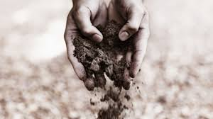
ADVANTAGES :-
BIOREMEDIATION ADVANTAGES
& DISADVANTAGES
PRESENTED BY – VISHAL SINGH
Bioremediation is a natural process and is therefore perceived by the public.
Bioremediation is useful for the complete destruction of a wide variety of contaminants.
Instead of transferring contaminants from one environmental medium to another, for example, from land to water or air, the complete destruction of target pollutants is possible.
Bioremediation can prove less expensive than other technologies that are used for cleanup of hazardous waste.
Bioremediation can often be carried out on site, often without causing a major disruption of normal activities.

Slide 2
DISADVANTAGES :-
BIOREMEDIATION ADVANTAGES
& DISADVANTAGES
PRESENTED BY – VISHAL SINGH
Bioremediation is limited to those compounds that are biodegradable. Not all compounds are sus­ceptible to rapid and complete degradation.
There are some concerns that the products of biodegradation may be more persistent or toxic than the parent compound.
Biological processes are often highly specific. microbial populations, suitable environmental growth conditions, and appropriate levels of nutrients and contaminants.
Bioremediation often takes longer than other treatment options.

